Slide 1

STOCK MARKET ANALYSIS AND PORTFOLIO MANAGEMENT
BY – PERINKUMAR PATEL

Slide 2
PROJECT OVERVIEW
Business Case - In the recent past, the industry of wealth management has seen a lot of growth. Every individual or business actively searches for opportunities to get the maximum returns. However, in most of the cases, they either lack the skills to identify the right investment opportunity, or there is a shortage of time for finding these opportunities. Hence, this gave rise to the dedicated individuals who perform this task on behalf of the investors for a commission - Portfolio managers.
A portfolio manager makes investment decisions and carries out other related activities on behalf of vested investors. They work with a team of analysts and researchers, and their main objective is to realise the needs of the investor and suggest a suitable portfolio that meets all the expectations. They are responsible for establishing the best investment strategy, selecting appropriate investments along with the right allocation. However, in doing so, they face a lot of competition in the form of other portfolio managers and rival firms. Therefore, the portfolio manager has to use the available resources to provide the best solution to the investor.

Slide 3
Objective
Our Objective is to suggest our client which stocks they can invest their funds for better returns and which has less risk.
We have to keep in mind about their requirements and based on that we have to give a comprehensive report so they can make decision.

Slide 4
Agenda
Our Client wants to invest their fund and to use the matured amount for establishing NGO , which our clients wants to establish with their batchmates to support sub_Saharan African region.
We have to give a suggestion to our client for investing in stock.

Slide 5
Steps used for analysis
Data exploration
Visualization
Stock analysis and portfolio management by using CAPM
Prediction on stock price
Reporting

Slide 6
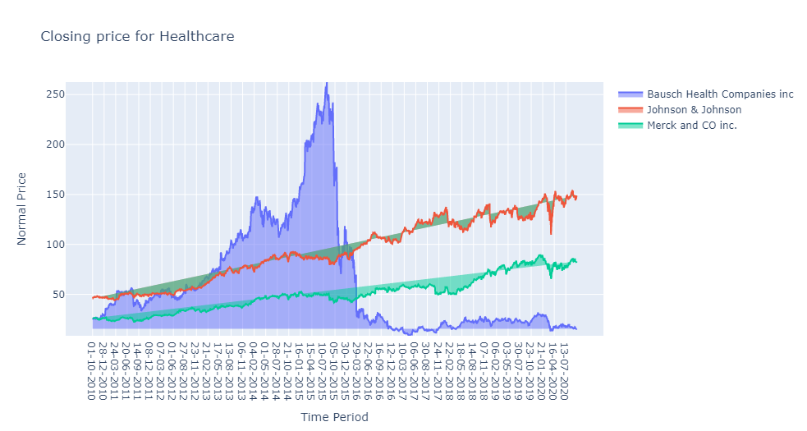
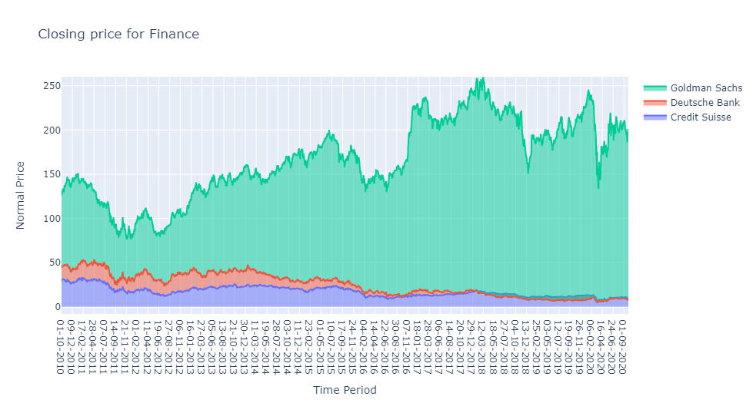
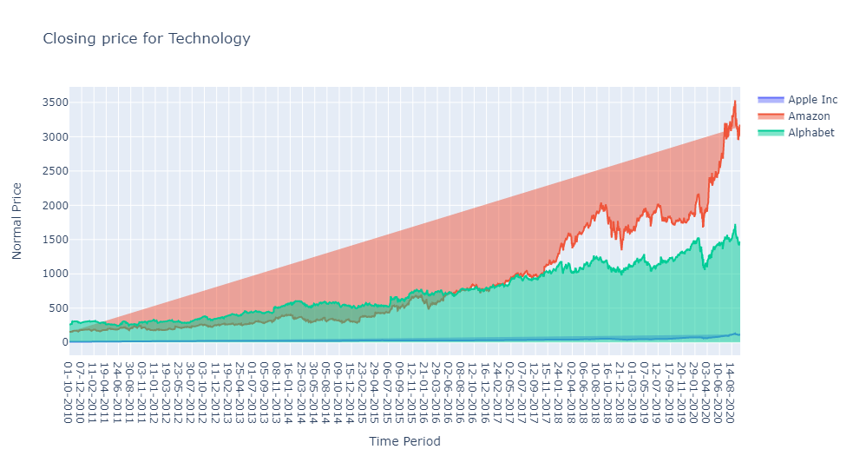
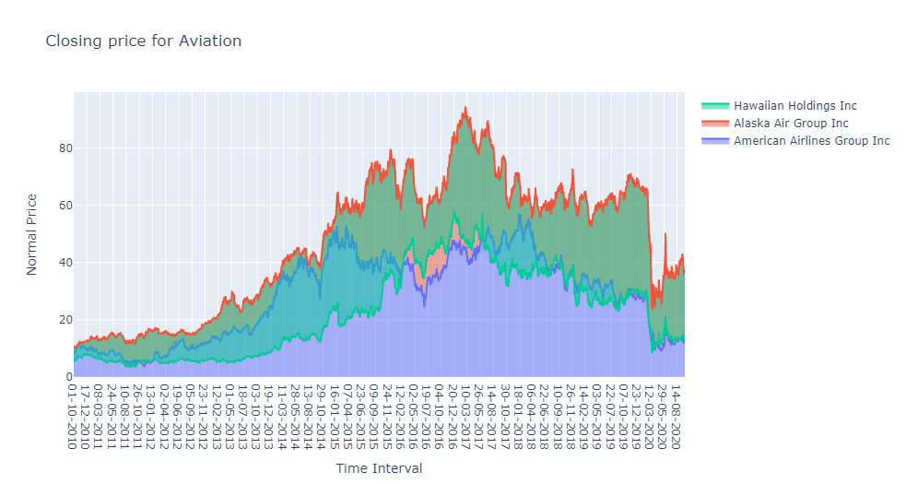
Visualization for Closing price

Slide 7
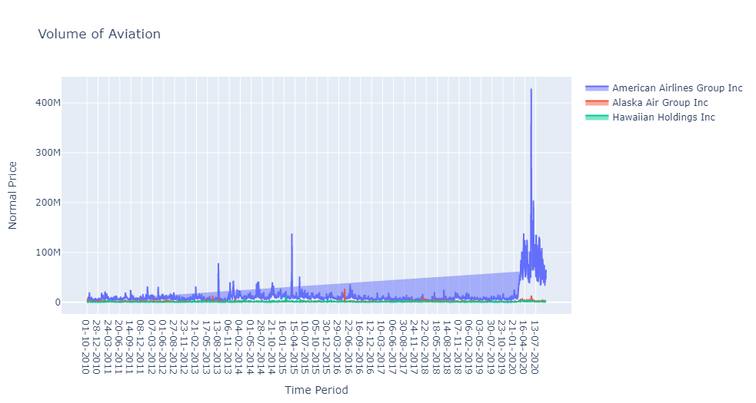
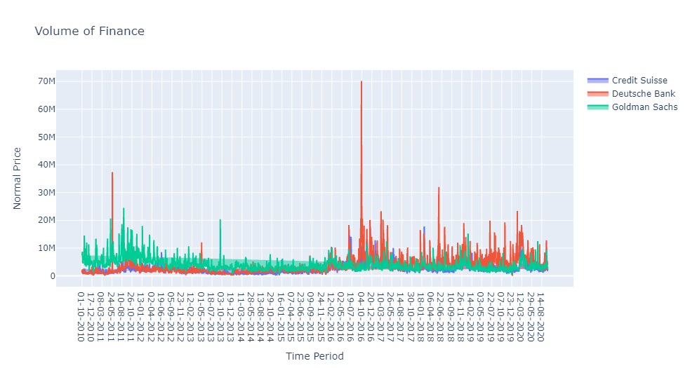
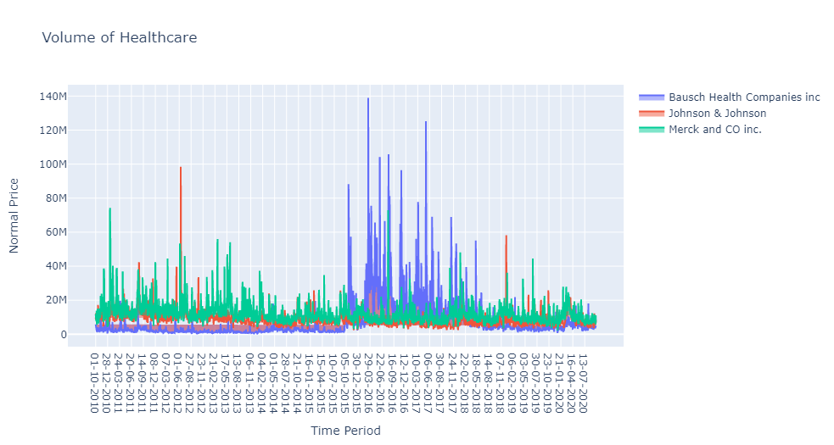
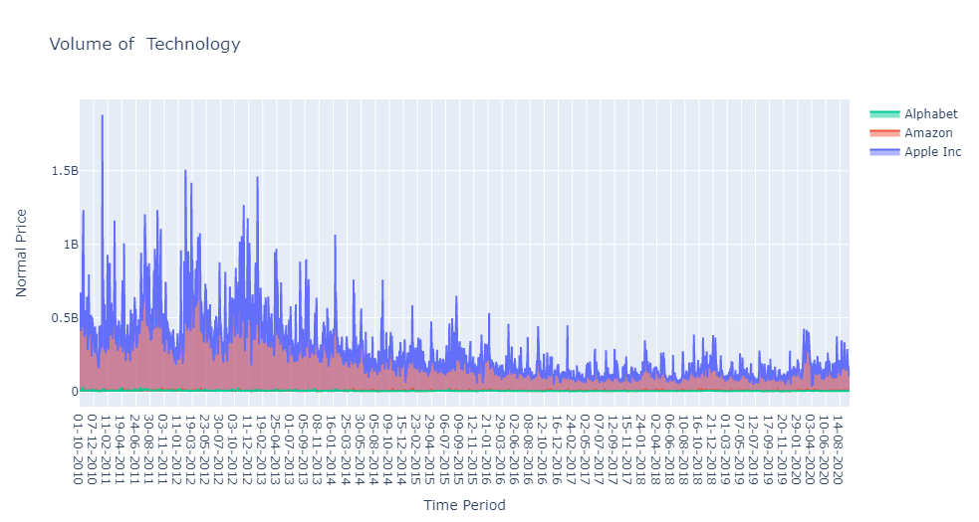
Visualization on Volume

Slide 8
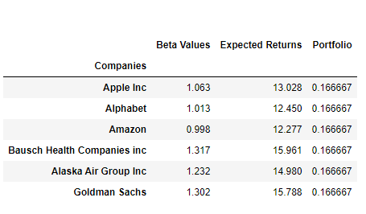
Capital Asset Pricing Model (CAPM)

Slide 9
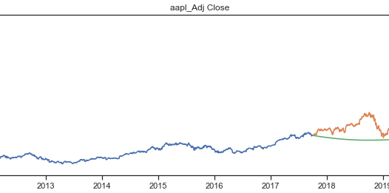
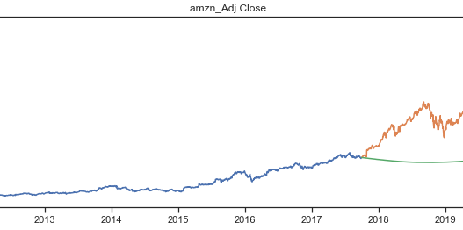
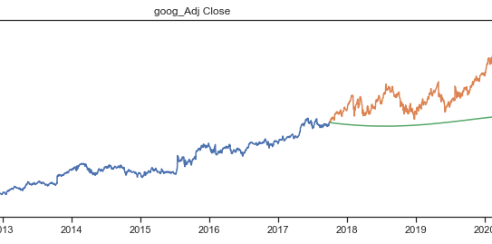
Forecast for Technology sector
As we can see here that the technology has a strong fundamental and less volatile.
So it will be a good investment.

Slide 10
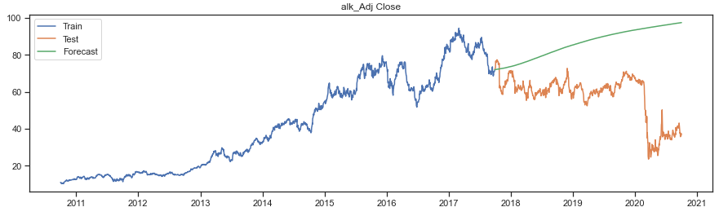
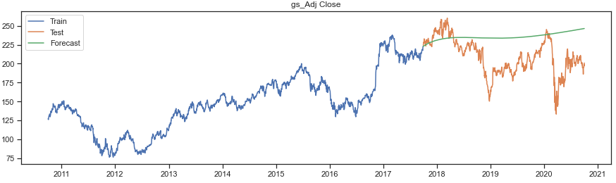
Forecast for Aviation and Finance sector
Aviation has a strong fundamental but due to covid there is a fall but it'll grow again.
As we can see that finance is little volatile but it will give a great Return.

Slide 11
Report
As per analysis I would suggest our client to invest in technology segment majorly in Apple Inc , Alphabet and Amazon because this is a less volatile and also having strong fundamental also providing good returns.
Also as per our analysis I would like to suggest our client make an investment in Goldman Sachs (Finance Sector) because it is a little volatile and provide great returns.
Also as per our analysis I would like to suggest our client make an investment in Alaska Air Group Inc. (Aviation Sector) because as we know that the aviation sector will never go out of market and based on it is strong fundamental background we know that It will move uptrend for a very long period of time because this is a segment is used on daily basis and can never be stop.

Slide 12
Thank you

